Slide 1
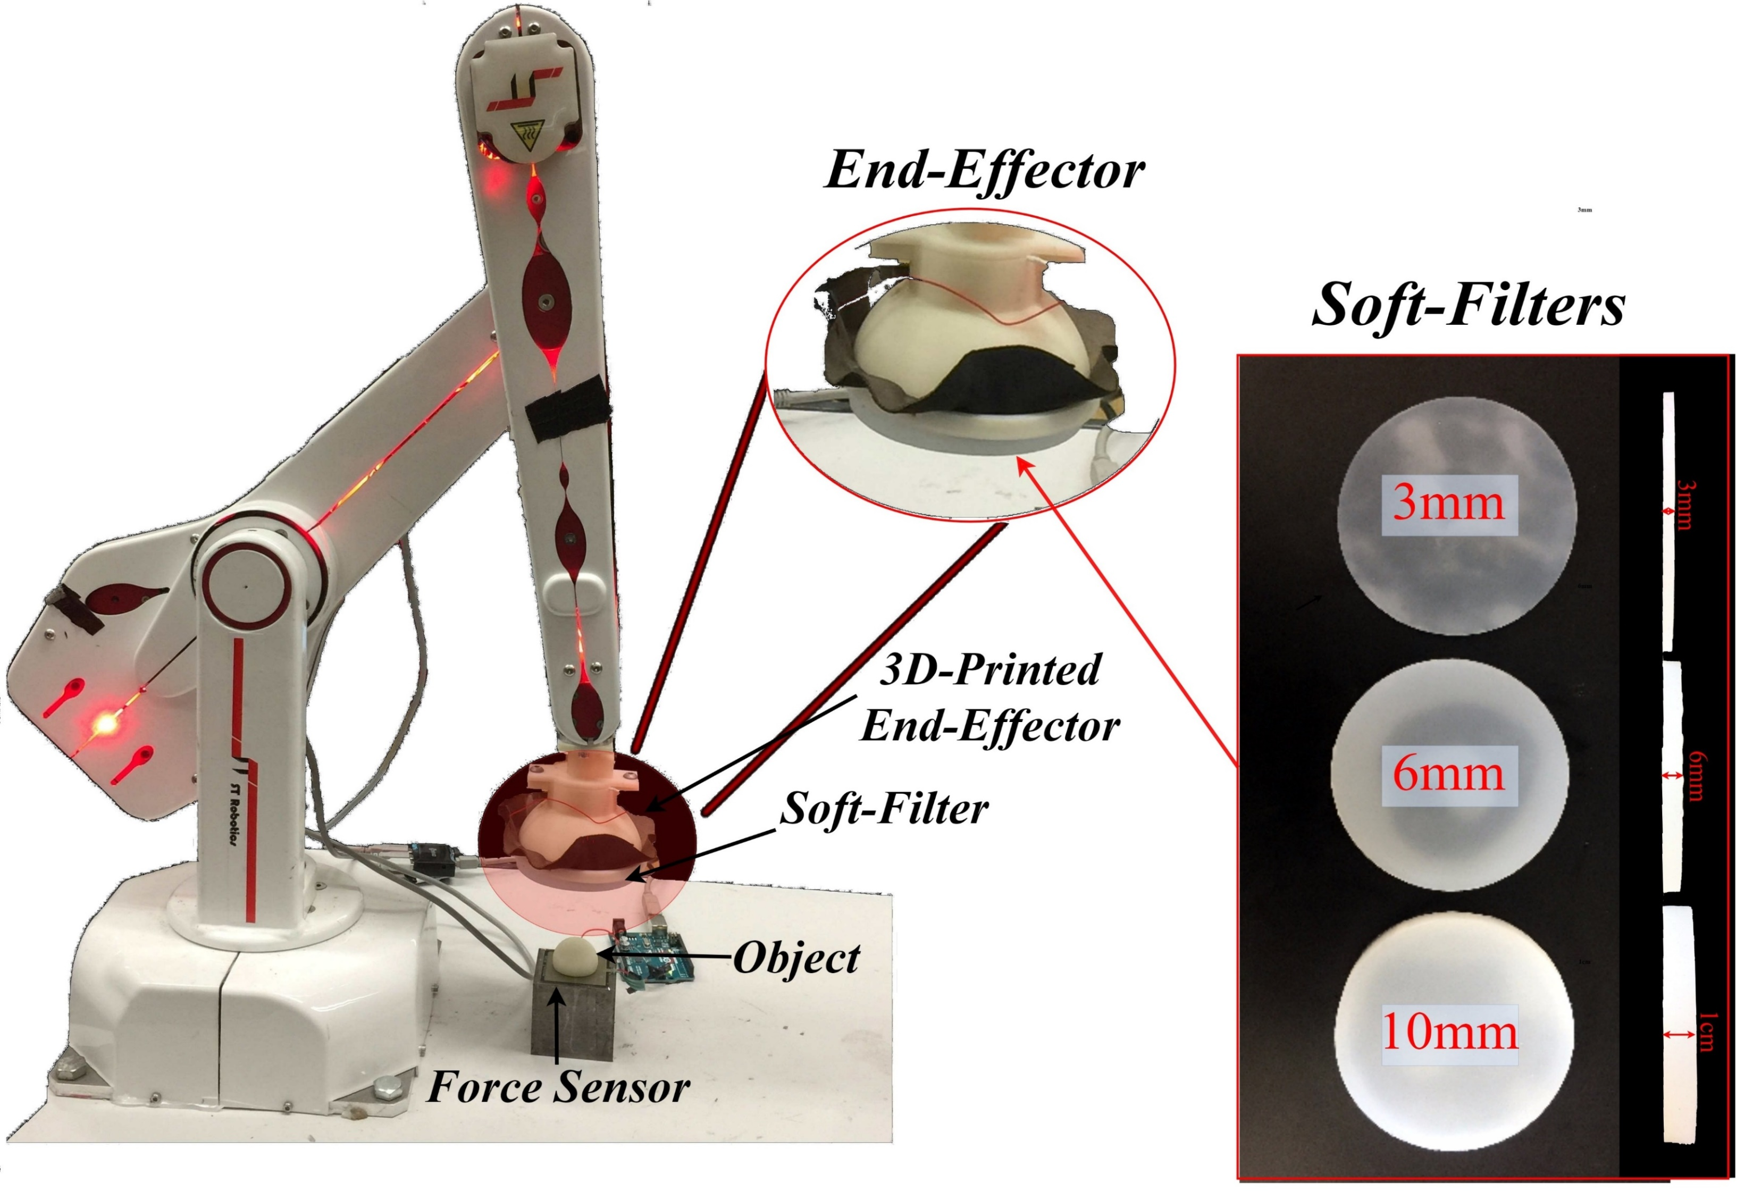
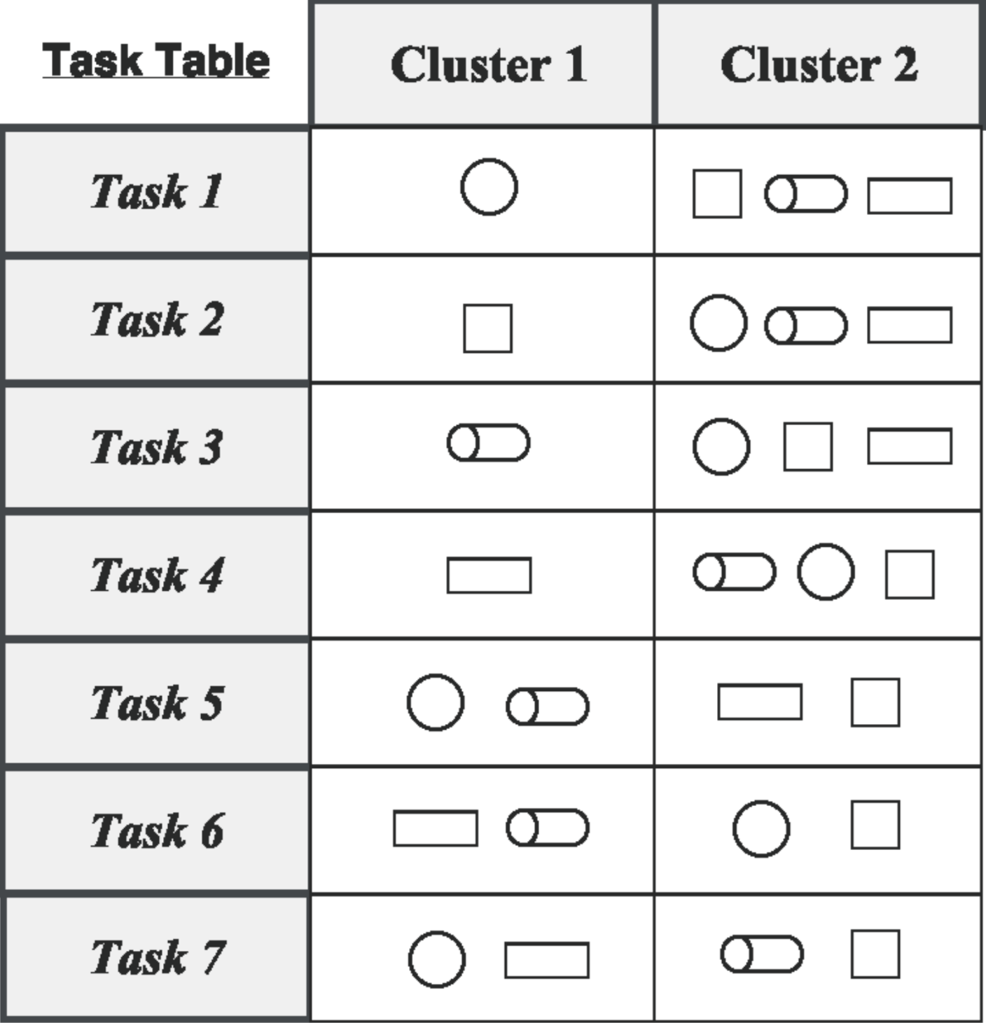
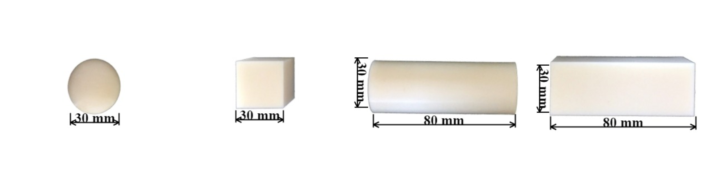
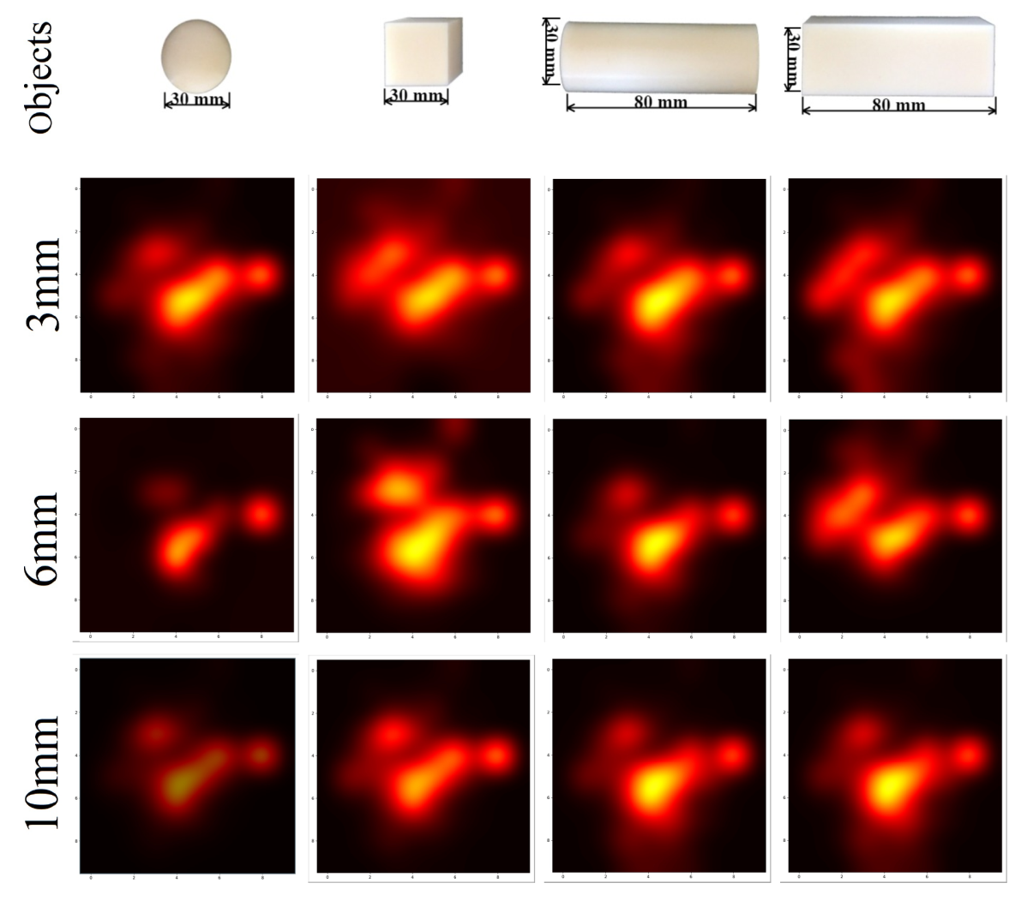
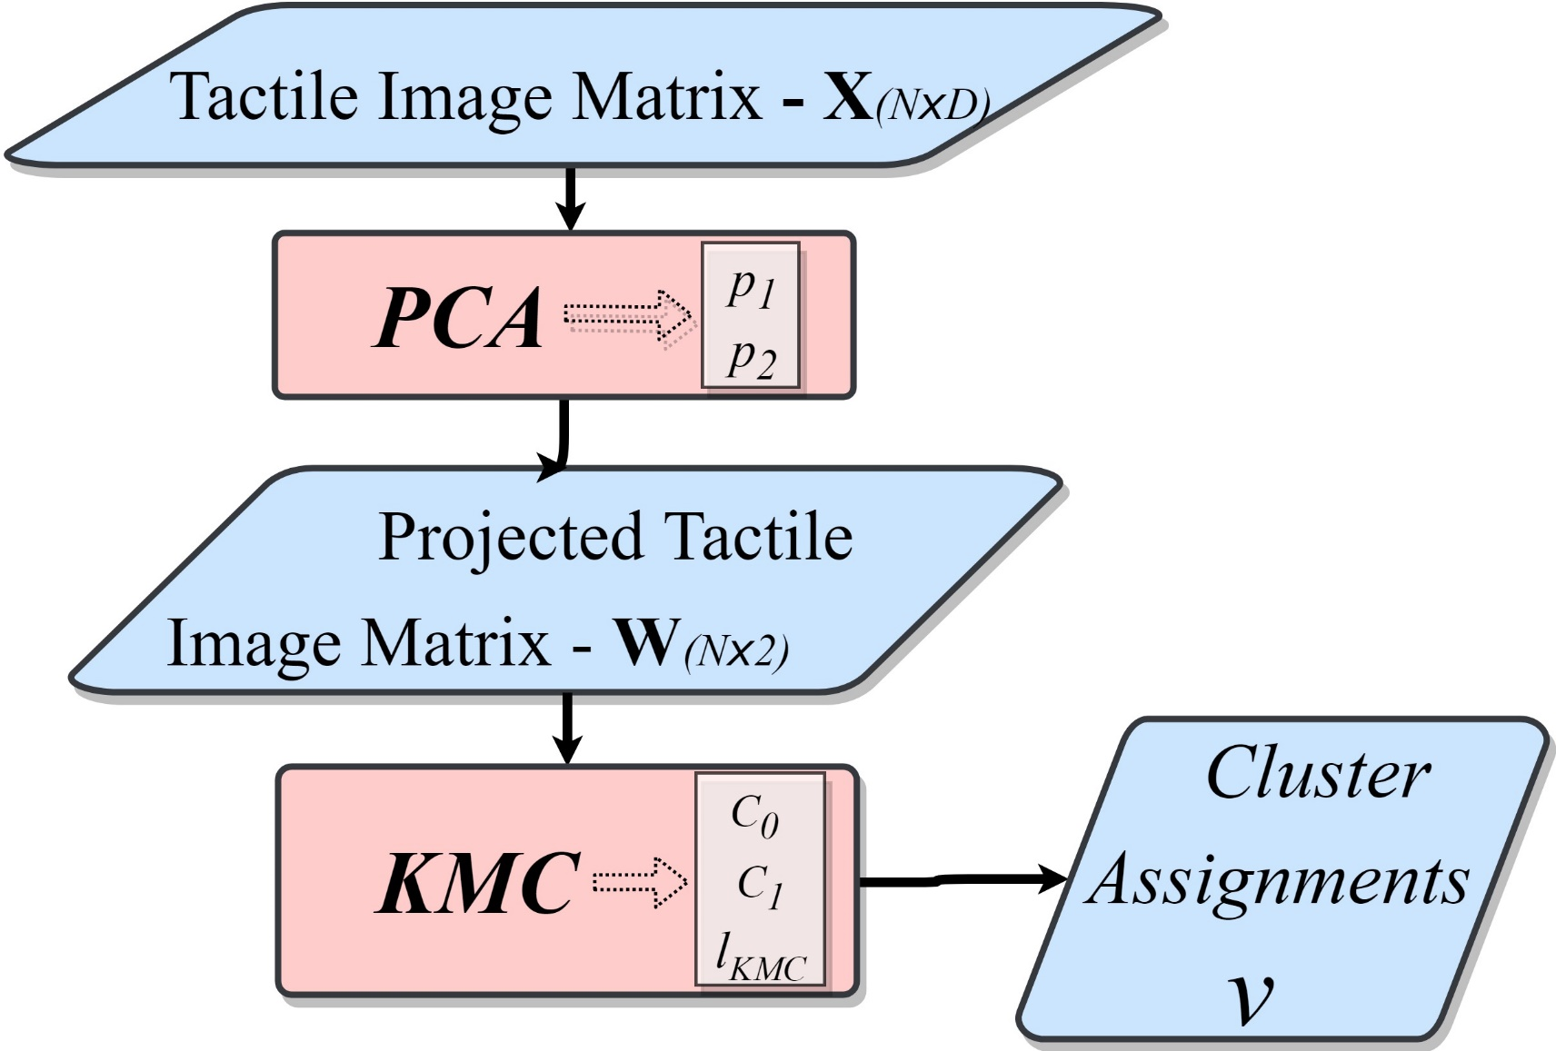


Soft Morphological Processing of Tactile Stimuli for Autonomous Category Formation
Luca Scimeca, Perla Maiolino and Fumiya Iida
Morphology affects tactile sensor response, pre-processing stimuli before inference can be done. It is fundamental we understand how the influence can change the robot perception of its surroundings.
Through morphology, wish to influence the sensor response to retrieve tactile information which simplifies a predetermined, tactile, object discrimination task.
Skin Sensor
Motivation & Hypothesis
Experimental Set-up
R12/5 Robotic Arm
Discrimination Tasks
4 3D-printed objects with two varying properties.
7 possible discrimination tasks, from the combinations of different objects.
Task 5 and 6 based on edge detection and elongation respectively.
Objects
Dimensionality Reduction & Clustering
Raw Tactile Images
Dimensionality Reduction & Clustering
Clusters in PCA subspace
Raw tactile images retrieved when probing each object in turn vertically.
Hotter areas correspond to tactile taxels detecting a higher pressure.
From the Raw tactile images, the tactile matrix X is formed.
PCA re-encodes objects in 2 dimensions.
K-Means Clustering is used to divide the objects into 2 groups.
Projected, 2-dimensional encoding of each probed object and the corresponding cluster guess.
Results
Task Optimization
Autonomous Category Formation Variations
Spatial Resolution Influence
The projected tactile change position according to the soft filter.
3 mm filter draws close in space objects with sharp edges (edge detection).
6mm soft filter induces clusters based on object elongation.
3mm
6mm
Depending on the used soft filter (morphology), the Autonomous Category Formation process forms qualitatively different clusters (optimized for different tasks).
Performing the experiments over different number of taxels shows the need of a high spatial resolution tactile sensor.
10mm
References
Hughes, J., Iida, F. (2018). Multi-functional soft strain sensors for wearable physiological monitoring, IEEE RAS International Conference on Soft Robotics (RoboSoft2018)
Iida, F., & Nurzaman, S. G. (2016). Adaptation of sensor morphology: an integrative view of perception from biologically inspired robotics perspective. Interface focus, 6(4).
Shimojo, M. (1997). Mechanical filtering effect of elastic cover for tactile sensor. IEEE Transactions on Robotics and Automation, 13(1), 128-132.

